Slide 1

National Accountability of conduct and ethics
PRESENTED BY:
Safi Ullah Khan (20PWCSE1943)
Abdul Wahab (20PWCSE1946)
Arbab Kalim Ullah (20PWCSE1931)
Hafsa Bukhari (20PWCSE1905)
PRESENTED TO:
Mam Anila Karim

Slide 2
Table of Content
Introduction to National Accountability
Key Concepts in National Accountability
Ethical Conduct in National Governance
Challenges to National Accountability
Strategies for Enhancing National Accountability
Conclusion and Call to Action

Slide 3
Definition of National Accountability
Responsibility of governments and institutions to be answerable for their actions. Includes being transparent about decisions and policies.
Responsibility to the Public: Governments and institutions are accountable for their actions, decisions, and policies, meaning they must explain and justify these to the public.
Answerability to Stakeholders: This responsibility extends beyond the public to include stakeholders such as regulatory bodies, advocacy groups, and affected communities.
Ensuring Oversight: National accountability involves mechanisms to ensure oversight, allowing for scrutiny and evaluation of government

Slide 4
Importance in Governance and Ethics
Transparency and Trust: National accountability is crucial for maintaining transparency and building trust in government actions and decisions.
Ethical Standards: It upholds ethical standards by ensuring that government institutions adhere to moral principles and guidelines.
Public Confidence: By being accountable, governments and institutions can inspire public confidence in their ability to serve the interests of the people.

Slide 5
Key Concepts in National Accountability
Accountability Mechanisms: Systems or processes that hold governments and institutions responsible for their actions.
Examples: A report that shows how money was spent, or a group that checks if laws are being followed.
Stakeholder Roles: Stakeholders are people or groups who have a say in what the government does.
Examples: Citizens who vote, organizations that speak up for certain issues, or experts who give advice.

Slide 6
Continued
Ensuring Oversight: This means making sure someone is watching to check that the government is doing things correctly.
Example: It's like having a teacher in a classroom to make sure students behave well and do their work.
Examples: A website where people can report problems, a law that protects whistleblowers, or a program that teaches officials about ethics.

Slide 7
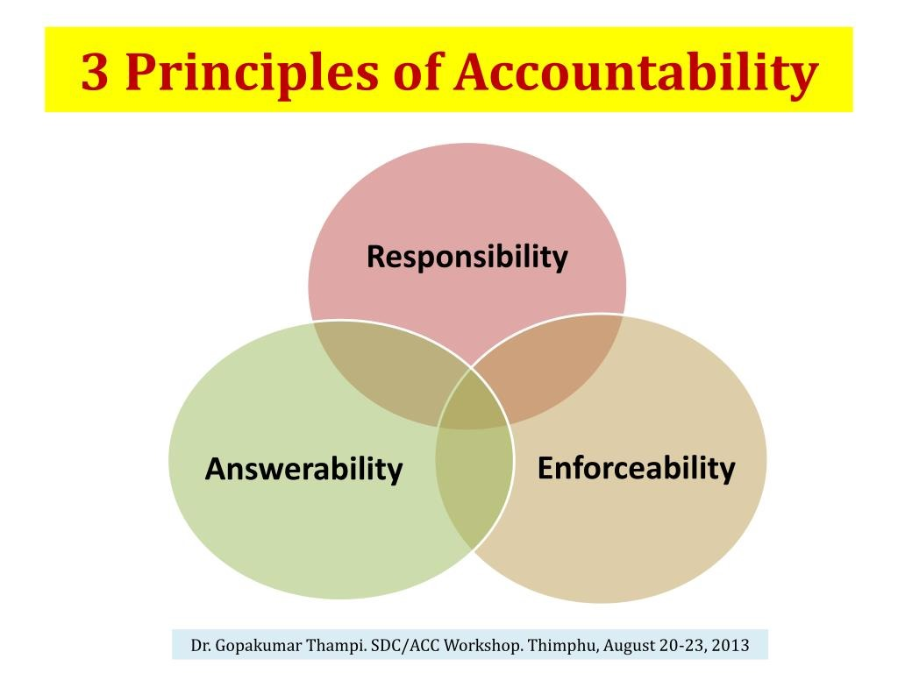


Slide 8
Ethical Conduct in National Governance
Principles of Ethical Conduct: These are rules or guidelines that help government officials make fair and honest decisions.
Example: Treating all citizens equally and making decisions based on what's best for everyone.
Importance of Ethical Leadership: Ethical leadership means leading by example and following ethical principles.
Example: A leader who is honest and fair inspires others to do the same, creating a culture of integrity.

Slide 9

Ethical Leadership

Slide 10
Example Case Study:
Imagine a city where the mayor promised to improve schools and parks. However, instead of using the money for these improvements, the mayor and some officials took the money for themselves. As a result, the schools and parks remained the same, and the people in the city suffered. When this was discovered, the mayor and those involved were removed from their positions and faced consequences for their actions. This case shows how unethical behavior by leaders can harm the community and why it's important to have ethical conduct in governance.

Slide 11
Challenges to National Accountability
Identifying Common Challenges: This means finding out the problems that make it hard to have accountability.
Example: Not having clear rules or ways to check if leaders are doing their jobs.
Factors Affecting Ethical Behavior: These are things that can influence how people behave in terms of honesty and fairness.
Example: Pressure to make more money might lead someone to act unethically.
Impact of Accountability Lapses: This is what happens when there are failures in accountability.
Example: If a government agency doesn't report its spending, it might waste money without anyone knowing.

Slide 12

Accountability steps

Slide 13
Strategies for Enhancing National Accountability
Being open about what the government does and involving people in decision-making.
Example: Publishing reports online and asking citizens for feedback on new policies.
Leadership and Organizational Culture: Having leaders who set good examples and creating a work environment that promotes honesty and fairness.
Example: A boss who listens to employees and encourages them to speak up about problems.
Recommendations for Improvement: Suggestions for making things better, based on what's not working well.
Example: Proposing new laws or policies to fix loopholes in the current system.

Slide 14

How to Improve Accountability

Slide 15
Conclusion
Accountability is crucial for good governance and ethical behavior. Continued efforts are needed to maintain and improve accountability. Stakeholders play a key role in promoting and upholding accountability in their respective areas.

Slide 16


Thank You!

